Slide 1
Agenda
Specification (Web Dashboard)
VCT Traceability Step 3 Lot Data Retrieval
11Aug’25_ Rev 00
Revision History
Rev No. | Revision date | Revision point | Reason | Requested By | Status

Slide 2
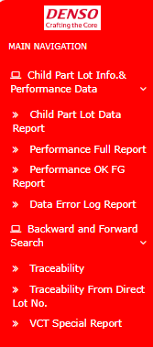
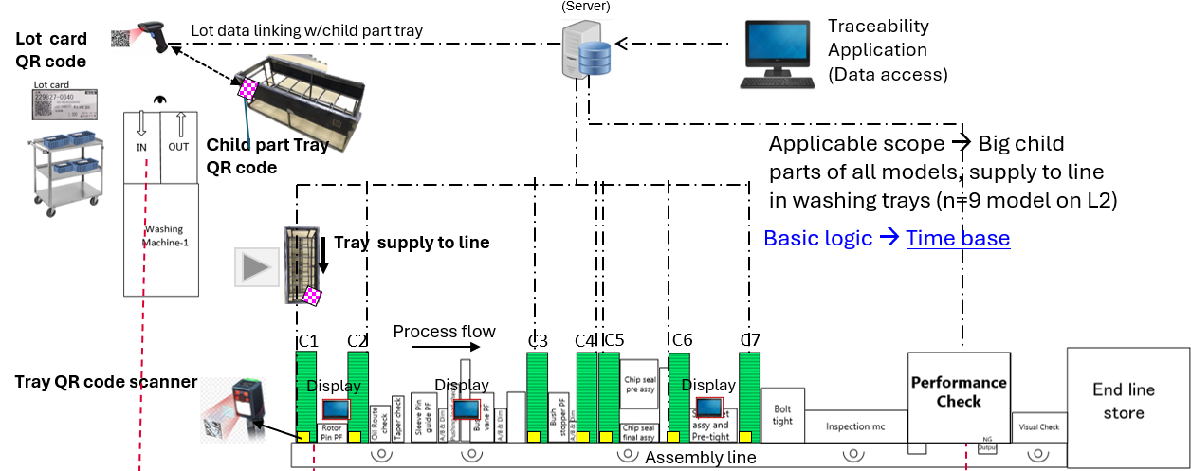
http://10.122.72.129:8084/VCT_WEB /Default.aspx
Keep same Basic Dashboard (Step 1,Step2,Step3 for Both lines)
Future all VCT related data should be from same dashboard.
1.Add this word “at Washing station”
(CSV report should include step3 mapped tray info also)
At washing station
2.Modify this & under Traceability tab add these modules
Traceability
3.Existing traceability search engine keep same
Step1 & 2 (from Washing to FG linkage)
Step 3 (FG linkage to Child Part lot info)
>>Lot info –Model Child part wise >>Lot info -Conveyor wise
>> Direct Lot No. search
>>Line Washing Tray records
>>Used Child part assy time
>>Traceback & Trace forward
4. New module Addition in existing dash.

Slide 3
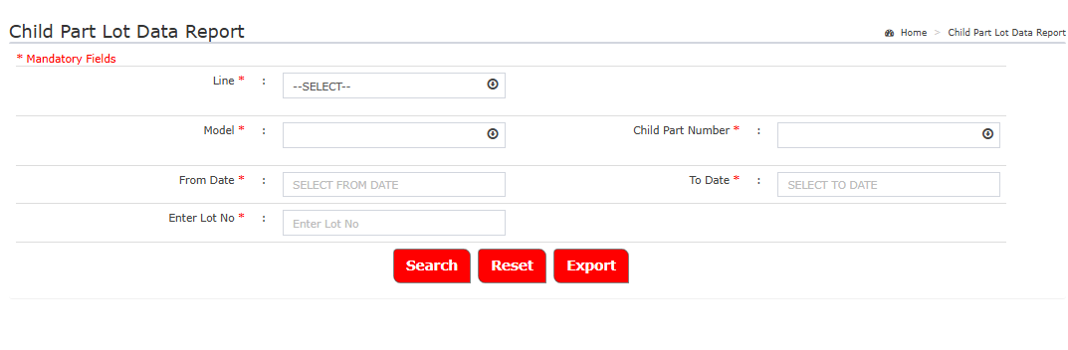
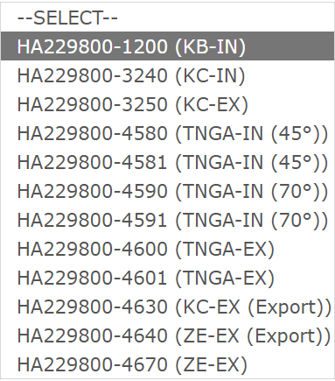
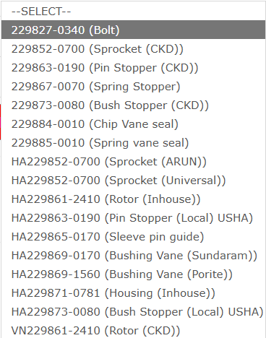
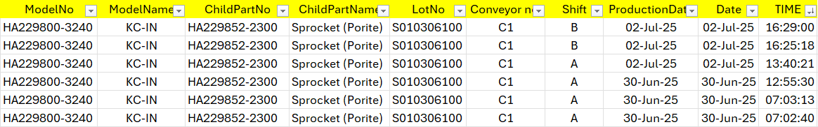

Lot info –Model Child part wise
*Input zone
Line *
<1,2>
Model*
Child Part No.*
Sorting Order➔ Newest to Oldest
Output (should be exportable in excel)

Slide 4
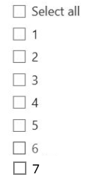

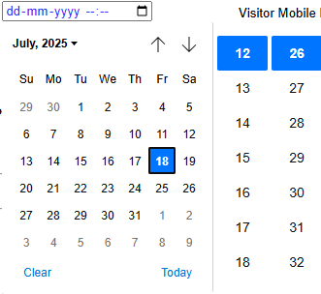
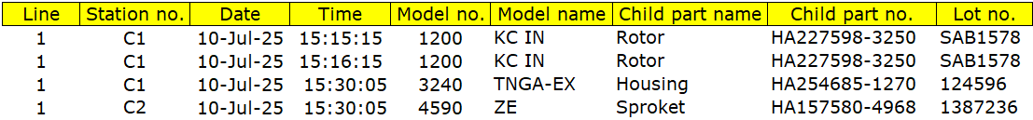
Lot info -Conveyor wise
*Input zone
There should be multi station selection provision
Line *
Station no./Conveyor No.*
<1,2>
From (Date, Time)*
To(Date, Time)*
From ➔
To ➔
Output (should be exportable in excel)
Sorting Order➔ Newest to Oldest

Slide 5

Direct Lot No. search
*Input zone
Line *
<1,2>
Model*
Child Part No.*
Enter Lot No.*
S010306100
Sorting Order➔ Newest to Oldest
Output (should be exportable in excel)

Slide 6
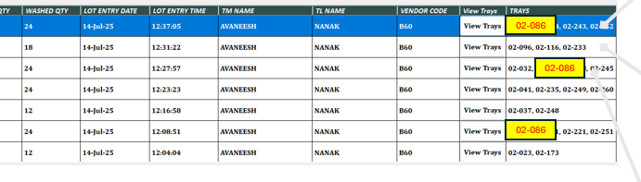
Line Washing Tray records
*Input zone
Line *
<1,2>
Search /Select Tray )*
History of Washing station (use @ washing line)
History of Assy line scanning (use @ Assy line)
Sorting Order➔ Newest to Oldest
Output (should be exportable in excel)

Slide 7
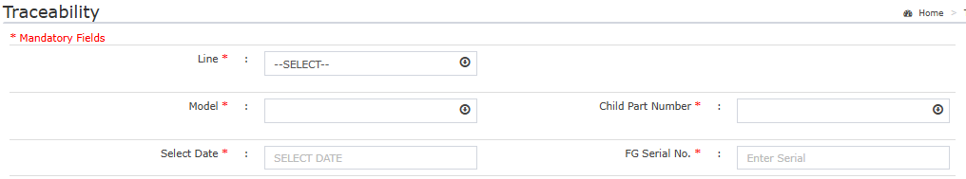
Used Child part assy time
*Input zone
Line *
Model*
Child Part No.*
Select FG Date.*
FG Serial No.*
System should provide each assembled child part time <follow time Master>
Model name | Model No. | FG Serial No | FG Time | C1 | C2 | C3 | C4 | C5 | C6 | C7
TNGA | 3240 | 2101214 | 2507025 14:14:15 | Rotor 13:50:00 14:04:00 | - | Housing 14:00 14:15 |  | Sprocket 14:02 14:03
 |  |  |  | Lot Nos. |  | Lot Nos. |  | Lot Nos.

Slide 8

Traceback & Trace forward from FG Serial No.
*Input zone
Line *
Model*
Child Part No.*
Select FG Date.*
FG Serial No.*
Sorting Order➔ Newest to Oldest
For each row there should be Trace forward
(as per time master standard)
Output (should be exportable in excel)

Slide 9
Reference slides

Slide 10
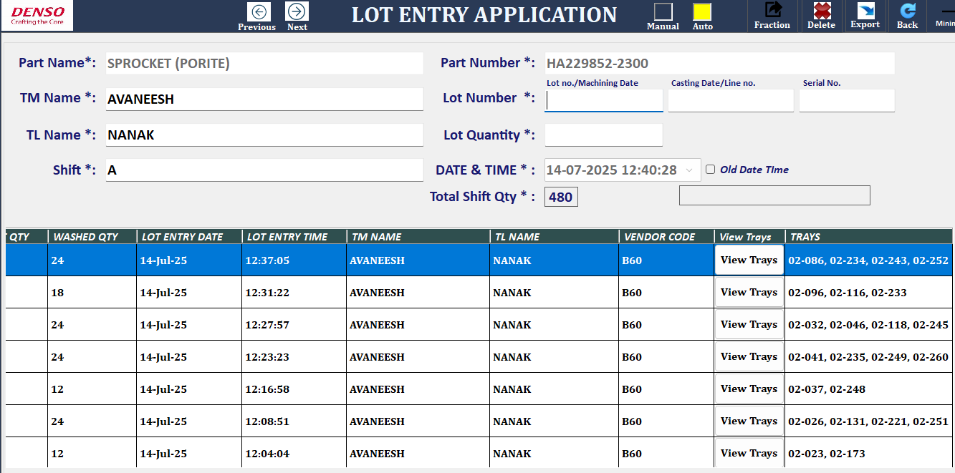
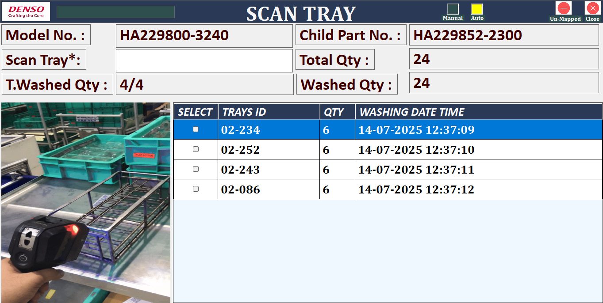
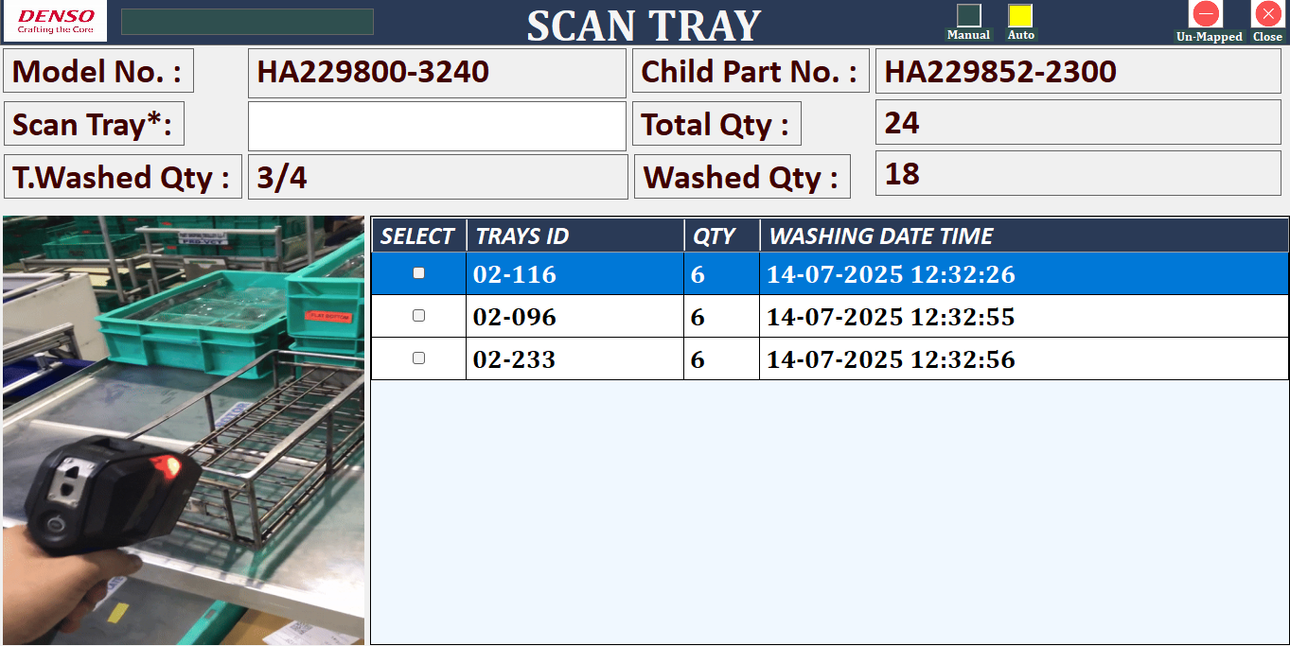

02-086
02-086
02-086

Slide 11
FG Serial No | FG Time | Model | C1 | C2 | C3 | C4 | C5 | C6 | C7
2101214 | 2507025 14:14:15 | ZE | Rotor 13:50:00 14:04:00 | - | Housing 14:00 14:15
 |  |  | Lot information

